Slide 1








Water quality analysis and prediction

Slide 2

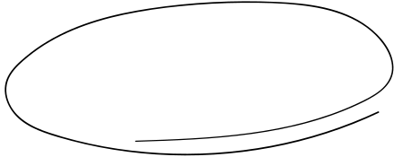

Contents
1
2
TEAM MEMBERS
PROBLEM STATEMENT
3
ABSTRACT

Slide 3




TEAM
sHREE
GAAYATHRI V
111720102146
YUVANTHI S
111720102178
VENMATHI J
111720102171
SHALINI V
111720102144

Slide 4






Problem Statement
Clean and safe water is an indispensable resource that directly impacts various aspects of human life, from drinking and sanitation to agriculture, industrial processes, and aquatic ecosystems. To analyze and build a model to ensure the availability of clean and safe water resources for both humans and environmental preservation.
‘’

Slide 5

Abstract
Water, constituting a significant portion of Earth's surface, is vital for life. However, rapid urbanization and industrialization have led to a troubling decline in water quality, resulting in severe health concerns. Traditional water quality assessment methods involving resource-intensive lab tests and analyses are impractical for real-time monitoring. The primary focus of the project is to leverage machine learning techniques in evaluating water quality. Water potability, a numerical metric for assessing water condition, is the central goal. A set of water quality parameters including pH, hardness, solids, chloramines, sulfate, conductivity, organic carbon, trihalomethanes, and turbidity are employed collectively as a feature vector to gauge overall water quality

Slide 6


Thanks!

